Slide 1
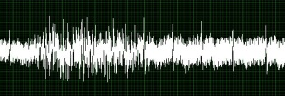
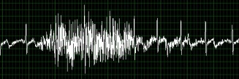




Skin Surface
Underlying Muscle
Body-to-Sensor Interface
Gel
Gel
EMG Sensor
Electrode
Signal (+)
Electrode
Signal (-)
Electrode
(Bias)
± 5 mV
~ 3 V
Analog Filter
Rotary Encoder
Power
3.3 V
3.3 V
ADS1299 (ADC)
5 V
Ticks
Battery Pack
CLK
MISO
MOSI
SPI
Data Processing
GPIO
Buck
Converter
Digital Filters
MSP432
Linear Converters
Rectified
Moving Average
3.3 V
Linear Transformation
Calibration
Error / Set-point Calculations
Torque
EMG Activity
Motor Control
User Interface
Motor-to-Body Interface
3.3 V
Display
Buttons
Motor Driver
12 V
3.3 V
Motor
Orthosis Structure
Arm and Elbow

Slide 2
Skin Surface
Underlying Muscle
Gel
Gel
EMG Sensor
Electrode
Signal (+)
Electrode
Signal (-)
Electrode
(Bias)
± 5 mV
~ 3 V
Analog Filter
Rotary Encoder
3.3 V
6 V
ADS1299 (ADC)
CLK
MISO
MOSI
3.3 V
Ticks
3.3 V
SPI
Data Processing
GPIO
MSP432

Slide 3
Body-to-Sensor Interface
6 V
EMG Sensors
Rotary Encoder
CLK
MISO
MOSI
Ticks
SPI
Data Processing
GPIO
Digital Filters
MSP432
3.3 V
Rectified
Moving Average
Linear Transformation
Calibration
Error / Set-point Calculations
Torque
EMG Activity
Motor Control
Motor-to-Body Interface
12 V
Motor Driver
3.3 V
Motor

